Slide 1
Unit 7: External Routing
7.1 Autonomous Systems
7.2 Border Gateway Protocol

Slide 2
Autonomous System (AS)
The Internet is a collection of networks, each controlled by different administrations
An AS is a network under a single administrative control with a single routing protocol
Identified by ‘AS number’
Examples: Networks of ISPs, hosting providers, telecommunications monopolists, multinationals, schools, hospitals, individuals or anyone needing policy discrimination
An AS
can independently decide who to exchange traffic with on the Net,
isn't dependent upon a third party for access.
Notes:
4

Slide 3
AS Numbers (ASNs)
ASNs assigned by ICANN are 16 bit values
64512 through 65535 are “private”
Currently over 47,000 in use (by the mid-2014)
Genuity: 1
MIT: 3
Harvard: 11
UC San Diego: 7377
AT&T: 7018, 6341, 5074, …
UUNET: 701, 702, 284, 12199, …
Sprint: 1239, 1240, 6211, 6242, …
…
ASNs represent units of routing policy
Notes:
https://en.wikipedia.org/wiki/Autonomous_system_(Internet)

Slide 4
Routing flow and packet flow
packet flow
egress
accept
announce
AS 1
Routing flow
AS2
announce
accept
ingress
packet flow
For networks in AS1 and AS2 to communicate:
AS1 must announce routes to AS2
AS2 must accept routes from AS1
AS2 must announce routes to AS1
AS1 must accept routes from AS2

Slide 5
Egress Traffic
Packets exiting the network
Based on
What information you send and to who
Based on your addressing and ASes
Based on others’ policy (what they accept from you and what they do with it)

Slide 6
Ingress Traffic
Packets entering your network
Ingress traffic depends on:
Route availability (what others send you)
Route acceptance (what you accept from others)
Policy and tuning (what you do with routes from others)
Peering and transit agreements

Slide 7
Types of Routes
Static Routes
configured manually
Connected Routes
created automatically when an interface is ‘up’
Interior Routes
Routes within an AS
Exterior Routes
Routes exterior to AS

Slide 8
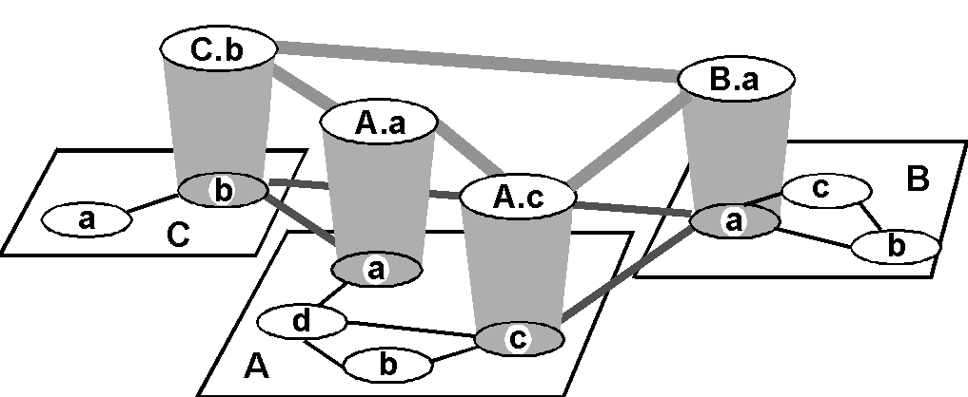
Internet AS Hierarchy
Inter-AS border (exterior gateway) routers
Intra-AS interior (gateway) routers

Slide 9
How Are Forwarding Tables Populated to implement Routing?
Statically
Dynamically
Administrator
manually configures
forwarding table entries
Routers exchange network reachability information using ROUTING PROTOCOLS. Routers use this to compute best routes
+ More control
+ Not restricted to
destination-based
forwarding
- Doesn’t scale
- Slow to adapt to
network failures
+ Can rapidly adapt to changes
in network topology
+ Can be made to scale well
- Complex distributed algorithms
- Consume CPU, Bandwidth, Memory
- Debugging can be difficult
- Current protocols are destination-based
In practice: a mix of these.
Static routing mostly at the “edge”

Slide 10
Architecture of Dynamic Routing
OSPF
BGP
AS 1
EIGRP
IGP = Interior Gateway Protocol
Metric based: OSPF, IS-IS, RIP,
EIGRP (cisco)
AS 2
EGP = Exterior Gateway Protocol
Policy based: BGP
The Routing Domain of BGP is the entire Internet
Used to convey routing information between ASes

Slide 11
Interior vs. Exterior Routing Protocols
Exterior
Specifically configured peers
Connecting with outside networks
Set administrative boundaries
Interior
Automatic discovery
Generally trust your IGP routers
Routes go to all IGP routers

Slide 12
The Gang of Four
Link State
Vectoring
OSPF
IGP
RIP
IS-IS
BGP
EGP
IGP – Interior Gateway Protocol
EGP – Exterior Gateway Protocol

Slide 13
Inter-AS Routing
Global connectivity is at stake.
Inevitably leads to one single protocol that every one must speak
Unlike many choices in intra-AS routing
Why do we need EGP?
Scalability (hierarchy, limit scope of failure)
Flexibility in choosing routes
Define administrative boundary
Policy (control reachability to prefixes)

Slide 14
Many Routing Processes Can Run on a Single Router
RIP Process
BGP Process
RIP Routing tables
BGP Routing tables
BGP
OSPF Process
OSPF Routing tables
RIP
Domain
OS kernel
OSPF
Domain
Forwarding Table Manager
Forwarding Table

Slide 15
Why exchange traffic?
The Internet is a Network of Networks
One provider will never have all customers
An ISP sells access to the Internet, so…
…must itself get attached to someone who is already attached to the Internet.
these interconnections can be either direct or indirect
most network connections are indirect
Two economic arrangements of interconnections
1) Transit Provider sells metered access to the Global Internet
2) Peering is a business relationship whereby two companies interconnect directly without charging, RECIPROCALLY exchange access to each others customers
Notes:
reciprocal
英 [ rɪˈsɪprəkl ] 美 [ rɪˈsɪprəkəl ]
考研 CET6 GRE IELTS
adj.相互的; 互惠的; 倒数的
n.倒数; 互相关联的事物
reciprocally
英 [ rɪ'sɪprəklɪ ] 美 [ rɪ'sɪprəklɪ ]
adv.相互地，相反地

Slide 16
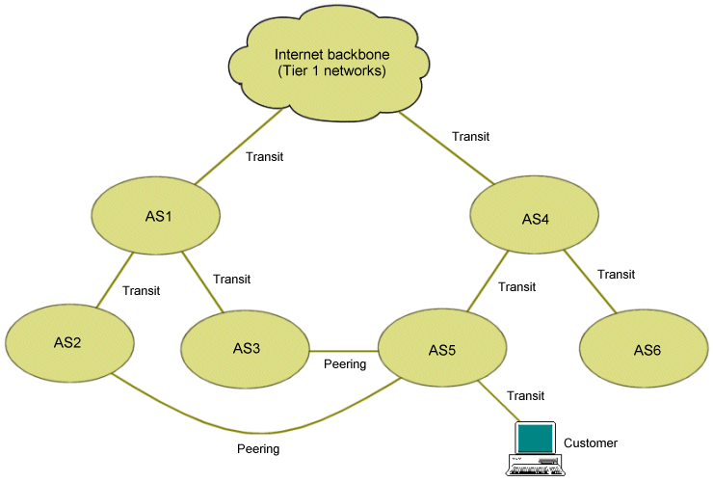
Features of peering and transit
Peering is open only to traffic coming from a peer's end-users or from networks that have bought transit.
A transit provider will not announce its peering and transit

Slide 17
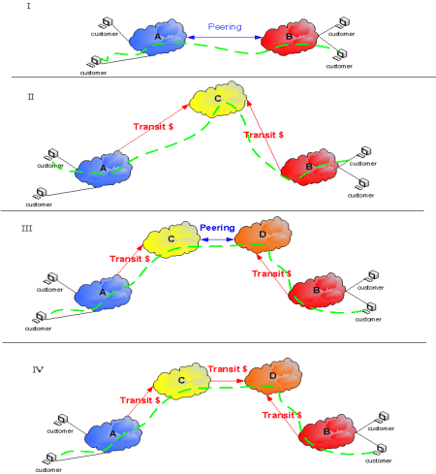
Peering and Transit

Slide 18
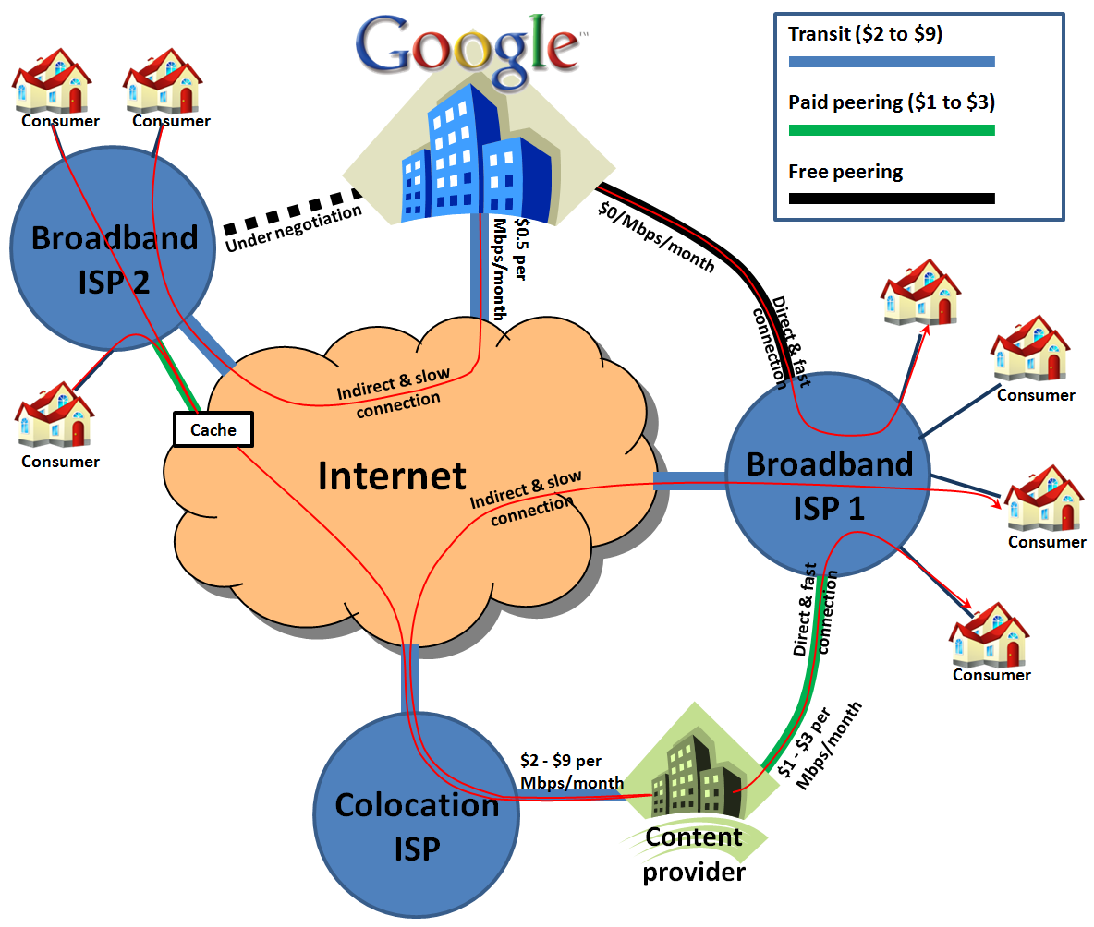

Slide 19
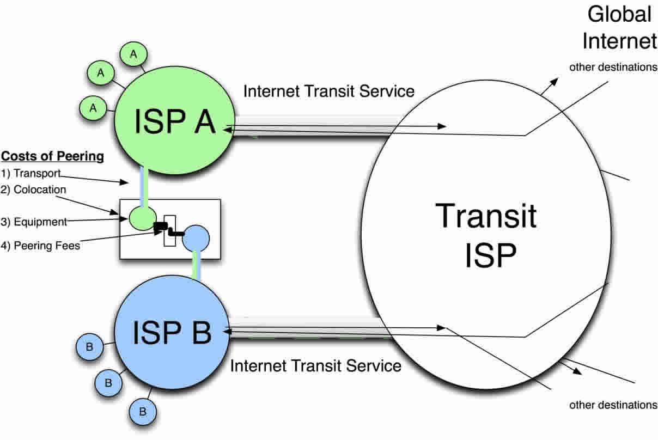
Internet eXchange Point (IXP)
Peering will happen at a location that is most convenient for both networks.
The original location of two peering networks attracts more networks to cluster
IXPs were established at those locations to facilitate peering
IXPs become valuable not only for peering, but also for buying and selling transit.

Slide 20

The economics of interconnection
Peer as much as you can, to avoid transit fees.
Use the savings from peering to expand your business and network.
Use the expansion of your business and network to become more attractive for others to peer with and to reach those that are attractive to peer with.
Establish IXPs in order to further lower the costs of peering, to bring together as many networks as possible, and to create locations where there is competition between providers of transit.
Repeat

Slide 21
Nontransit vs. Transit ASs
ISPs (often)
have transit
networks
ISP 2
ISP 1
Traffic NEVER
flows from ISP 1
through NET A to ISP 2
(At least not intentionally!)
NET A
Nontransit AS might be a corporate
or campus network.
Could be a “content provider”
IP traffic

Slide 22
Selective Transit
NET B
NET C
NET A provides transit
between NET B and NET C
and between NET D
and NET C
NET A does NOT
provide transit
Between NET D
and NET B
NET A
NET D
IP traffic
Most transit networks transit in a selective manner…

Slide 23
Customers and Providers
provider
provider
customer
IP traffic
customer
Customer pays provider for access to the Internet

Slide 24
Customers Don’t Always Need BGP
provider
Nail up routes 192.0.2.0/24
pointing to customer
Nail up default routes 0.0.0.0/0
pointing to provider.
customer
192.0.2.0/24
Static routing is the most common way of connecting an AS to the Internet.
This helps explain why BGP is a mystery to many …
Notes:
nail up 搜索网络
英 [neil ʌp] 美 [nel ʌp]
将（某物）钉在高处[钉在公共场合]; 将（某物）钉牢，钉紧;

Slide 25
Customer-Provider Hierarchy
IP traffic
provider
customer

Slide 26
The Peering Relationship
N1
N3
N2
Peers provide transit between
their respective customers
Peers do not provide transit
between peers
Peers (often) do not exchange $$$
peer
peer
provider
customer
traffic
allowed
traffic NOT
allowed

Slide 27
Peering Provides Shortcuts
peer
peer
Peering also allows connectivity between
the customers of “Tier 1” providers.
provider
customer

Slide 28
Peering Wars
Peer
Don’t Peer
Reduces upstream transit costs
Can increase end-to-end performance
May be the only way to connect your customers to some part of the Internet (“Tier 1”)
You would rather have customers
Peers are usually your competition
Peering relationships may require periodic renegotiation
Peering struggles are by far the most
contentious issues in the ISP world!
Peering agreements are often confidential.
Notes:
competitor
英 [kəmˈpetɪtə(r)] 美 [kəmˈpɛtɪtɚ]
n. 竞争者; 对手;
变形 复数: competitors
competition 搜索网络
英 [ˌkɒmpəˈtɪʃn] 美 [ˌkɑmpəˈtɪʃn]
n. 竞争; 比赛; 竞争者; [生]生存竞争;
变形 复数: competitions

Slide 29
Unit 7: External Routing
7.1 Autonomous Systems
7.2 Border Gateway Protocol

Slide 30

Internet inter-AS routing: BGP
BGP (Border Gateway Protocol) v4: the de facto EGP standard of today’s global Internet
BGP provides each AS a means to:
Obtain subnet reachability information from neighboring ASs.
Propagate reachability information to all AS-internal routers.
Determine “good” routes to subnets based on reachability information and policy.
allows subnet to advertise its existence to rest of Internet: “I am here”

Slide 31
BGP-4
Is a Policy-Based routing protocol
Relatively simple protocol, but configuration is complex and the entire world can see, and be impacted by your mistakes
Pakistan Telecom and YouTube
1989 : BGP-1 [RFC 1105]
Replacement for EGP (1984, RFC 904)
1990 : BGP-2 [RFC 1163]
1991 : BGP-3 [RFC 1267]
1995 : BGP-4 [RFC 1771]
Support for Classless Interdomain Routing (CIDR)

Slide 32

Pakistan YouTube incident adds to international outage (February 24, 2008)
Pakistan government instituted a ban on YouTube site
Pakistan Telecom routed the address block that YouTube's servers are into a "black hole”, →wrongly claimed to be the legitimate destination of YouTube.
The message started being replicated on the Internet world-wide
Other Internet service providers started having trouble accessing the YouTube site.
Misconfigurations of iBGP happen regularly and are usually the result of an error
“Human to Err and to Err is Computer
Computer to Err and to Err is Human”
Question?: Wherever there is a human, there is an error. Computers are there to make errors! Whenever there is a computer, there is an error, humans are there to make errors!

Slide 33
BGP basics (1)
Routing protocol used between ASes
if you aren’t connected to multiple ASes, you don’t need BGP :-)
Runs over TCP
Neither clear links state based, nor distance vector based
Sort of hybrid: Path vector protocol
Incremental update
Can have multiple paths for a given prefix
Picks the best path and installs in the IP forwarding table
Policies applied (through attributes) influences BGP path selection

Slide 34
BGP basics (2)
pairs of routers (BGP peers) exchange routing info over semi-permanent TCP connections: BGP sessions
BGP sessions need not correspond to physical links.
Two types of BGP neighbor relationships:
an external BGP (eBGP) session: a BGP session that spans two ASs
an internal BGP (iBGP) session: a BGP session between routers in the same AS
eBGP session
3c
iBGP session
2c
3a
3b
2a
AS3
2b
1c
AS2
1a
1b
AS1
1d

Slide 35
BGP basics (3)
when AS2 advertises a prefix to AS1:
AS2 promises it will forward datagrams towards that prefix.
AS2 can aggregate prefixes in its advertisement
AS2 four subnets 138.16.64/24
138.16.65/24
138.16.66/24
138.16.67/24
AS2 three subnets 138.16.64/24
138.16.65/24
138.16.66/24
AS3 subnet:
138.16.67/24
aggregate prefix
to AS1
138.16.64/22
aggregate prefix
to AS1
138.16.64/22
AS3 advertise
to AS1
138.16.67/24
eBGP session
3c
iBGP session
2c
3a
3b
2a
AS3
2b
1c
AS2
1a
1b
AS1
1d

Slide 36
Distributing reachability info
using eBGP session between 3a and 1c, AS3 sends prefix reachability info to AS1.
1c can then use iBGP do distribute new prefix info to all routers in AS1
1b can then re-advertise new reachability info of AS3 to AS2 over 1b-to-2a eBGP session
when router learns of new prefix, it creates entry for prefix in its forwarding table.
eBGP session
3c
iBGP session
2c
3a
3b
2a
AS3
2b
1c
AS2
1a
1b
AS1
1d

Slide 37
Purpose of eBGP
Share connectivity information across Ases
Network Layer Reachability Information (NLRI)
3c
You can reach net D via me
3a
2c
3b
2a
AS3
2b
D
1c
AS2
1a
1b
eBGP session
AS1
1d
iBGP session
Table at router 1b
Dest. | Next hop
D | 2a

Slide 38
iBGP: carrying info within an AS
3c
3a
Announce net D
2c
3b
iBGP
2a
AS3
2b
D
1c
AS2
1a
1b
eBGP session
AS1
1d
iBGP session

Slide 39
Relationship between BGP speaker and AS
Each AS designates a border router to speak on its behalf
BGP
speaker
AS₁
BGP
speaker
AS₂
BGP speaker
BGP speaker
AS₃
BGP speaker
AS₄
AS₅

Slide 40
BGP speakers exchange path vectors
The BGP speaker of AS₂ inform the BGP speaker of backbone, “To reach N₁, N₂, N₃ and N₄, you can pass by AS₂”
local ISP（AS₄）
N₁， N₂
regional ISP
（AS₂）
local ISP（AS₅）
N₃， N₄
backbone
（AS₁）
local ISP（AS₆）
N₅
regional ISP
（AS₃）
local ISP（AS₇）
N₆， N₇

Slide 41
BGP speakers exchange path vectors
Backbone sends notification: “To reach N₅, N₆ and N₇, you can follow the path (AS₁, AS₃).”
local ISP（AS₄）
N₁， N₂
regional ISP
（AS₂）
local ISP（AS₅）
N₃， N₄
backbone
（AS₁）
local ISP（AS₆）
N₅
regional ISP
（AS₃）
local ISP（AS₇）
N₆， N₇

Slide 42
BGP routing policy
legend:
provider
B
network
X
W
A
customer
C
network:
Y
NOTE: A,B,C,x,w,y are ASs, not routers
A,B,C are backbone provider networks
x,w,y are stub networks and customers (of provider networks)
Stub networks: the source/destination of all traffic leaving/entering the network
w and y are clearly stub networks
Stub networks are typically no need for BGP
x is a dual-homed stub network: attached to two networks
x advertises (to its neighbors B and C) that it has no paths to any other destinations except itself.
E.g., x does not want to route from B via x to C, .. so x will not advertise to B a route to C

Slide 43
BGP routing policy (2)
legend:
provider
B
network
X
W
A
customer
C
network:
Y
A advertises path AW to B
B advertises path BAW to X
Should B advertise path BAW to C?
No way! B gets no “revenue” for routing CBAW since neither W nor C are B’s customers
B wants to force C to route to w via A
B wants to route only to/from its customers!

Slide 44
BGP Peers
A
C
AS 100
AS 101
220.220.8.0/24
220.220.16.0/24
B
D
BGP speakers are called peers
E
AS 102
Peers in different AS’s are called External Peers
220.220.32.0/24
eBGP TCP/IP
Peer Connection
Note: eBGP Peers normally should be directly connected.

Slide 45
BGP Peers
A
C
AS 100
AS 101
220.220.8.0/24
220.220.16.0/24
B
D
BGP speakers are called peers
E
AS 102
Peers in the same AS are called Internal Peers
220.220.32.0/24
iBGP TCP/IP
Peer Connection
Note: iBGP Peers don’t have to be directly connected.

Slide 46
BGP Peers
A
C
AS 100
AS 101
220.220.8.0/24
220.220.16.0/24
B
D
BGP Peers exchange Update messages containing Network Layer Reachability Information (NLRI)
E
AS 102
220.220.32.0/24
BGP Update
Messages

Slide 47
Configuring BGP Peers
AS 100
eBGP TCP Connection
AS 101
222.222.10.0/30
A
.2
220.220.8.0/24
.1
B
.2
.1
C
.2
220.220.16.0/24
.1
D
interface Serial 0
ip address 222.222.10.2 255.255.255.252
router bgp 100
network 220.220.8.0 mask 255.255.255.0
neighbor 222.222.10.1 remote-as 101
interface Serial 0
ip address 222.222.10.1 255.255.255.252
router bgp 101
network 220.220.16.0 mask 255.255.255.0
neighbor 222.222.10.2 remote-as 100
BGP Peering sessions are established using the BGP “neighbor” configuration command
External (eBGP) is configured when AS numbers are different

Slide 48
Configuring BGP Peers
AS 100
AS 101
iBGP TCP Connection
222.222.10.0/30
A
.2
220.220.8.0/24
.1
B
.2
.1
C
.2
220.220.16.0/24
.1
D
interface Serial 1
ip address 220.220.16.2 255.255.255.252
router bgp 101
network 220.220.16.0 mask 255.255.255.0
neighbor 220.220.16.1 remote-as 101
interface Serial 1
ip address 222.220.16.1 255.255.255.252
router bgp 101
network 220.220.16.0 mask 255.255.255.0
neighbor 220.220.16.2 remote-as 101
BGP Peering sessions are established using the BGP “neighbor” configuration command
External (eBGP) is configured when AS numbers are different
Internal (iBGP) is configured when AS numbers are same

Slide 49
BGP Operations (Simplified)
Establish session on
TCP port 179
AS1
BGP session
Exchange all
active routes
AS2
While connection
is ALIVE exchange
route UPDATE messages
Exchange incremental
updates

Slide 50
Four Types of BGP Messages
OPEN: opens TCP connection to peer and authenticates sender
UPDATE: advertises new path (or withdraws old)
KEEPALIVE keeps connection alive in absence of UPDATES; also ACKs OPEN request
NOTIFICATION: reports errors in previous msg; also used to close connection
announcement
=
prefix + attributes values

Slide 51
BGP message header
bit 16 2 1
marker
Total len.
type
BGP header
BGP main part
TCP header
BGP message
IP header
TCP datagram

Slide 52
BGP OPEN Message
0
1
2
3
Marker (security and message delineation)
Length
Type: open
version
My autonomous system
Hold time
BGP identifier
Optional parameters <type, length, value>
Parameter length
My AS: id assigned to that AS
Hold time: max interval between KEEPALIVE or UPDATE messages
BGP ID: address of one (typically virtual) interface and is same for all messages

Slide 53
BGP NOTIFICATION Message
0
1
2
3
Marker (security and message delineation)
Length
Type: NOTIFICATION
Error code
Data
Error sub-code
Used for error notification (update error, expired timer, FSM, cease)
TCP connection is closed immediately after notification.
Notes:
delineation
英 [dɪˌlɪnɪ'eɪʃn] 美 [dɪˌlɪnɪ'eɪʃn]
描绘;
delineate
英 [dɪˈlɪnieɪt] 美 [dɪˈlɪniˌet]
vt. 勾画，描述;

Slide 54
BGP KEEPALIVE Message
0
1
2
3
Marker (security and message delineation)
Length
Type: KEEPALIVE
Sent periodically (but before hold timer expires) to peers to ensure connectivity.
Sent in place of an UPDATE message.
Note: hold_time = zero means no keepalives will be sent

Slide 55
BGP Attributes
Not all attributes
need to be present in
every announcement
Value Code Reference
----- --------------------------------- ---------
1 ORIGIN [RFC1771]
2 AS_PATH [RFC1771]
3 NEXT_HOP [RFC1771]
4 MULTI_EXIT_DISC [RFC1771]
5 LOCAL_PREF [RFC1771]
6 ATOMIC_AGGREGATE [RFC1771]
7 AGGREGATOR [RFC1771]
8 COMMUNITY [RFC1997]
9 ORIGINATOR_ID [RFC2796]
10 CLUSTER_LIST [RFC2796]
11 DPA [Chen]
12 ADVERTISER [RFC1863]
13 RCID_PATH / CLUSTER_ID [RFC1863]
14 MP_REACH_NLRI [RFC2283]
15 MP_UNREACH_NLRI [RFC2283]
16 EXTENDED COMMUNITIES [Rosen]
...
255 reserved for development
From IANA: http://www.iana.org/assignments/bgp-parameters

Slide 56
Path attributes & BGP routes
two important attributes:
AS-PATH: contains ASs through which prefix advertisement has passed: e.g, AS 67, AS 17
NEXT-HOP: is the router interface that begins the AS-PATH and indicates specific internal-AS router to next-hop AS. (may be multiple links from current AS to next-hop-AS)
when gateway router receives route advertisement, uses import policy to accept/decline.

Slide 57
BGP route selection
router may learn about more than 1 route to same prefix. Router must select route.
Sequentially invoked elimination rules:
local preference value attribute: policy decision up to AS’s network administrator
- Highest values are selected
shortest AS-PATH
- Distance vector algorithm
- Distance metric: # AS hops, NOT # router hops
closest NEXT-HOP router: hot potato routing
- Least-cost path determined by intra-AS algorithm
additional criteria (can be more complicated)

Slide 58
Route Selection Summary
Routes are assigned a local preference value as one of their attributes.
Highest Local Preference
Enforce relationships
Shortest ASPATH
Lowest MED
i-BGP < e-BGP
Traffic engineering
Lowest IGP cost
to BGP egress
Lowest router ID
Throw up hands and
break ties

Slide 59
Attributes are Used to Select Best Routes
192.0.2.0/24
pick me!
192.0.2.0/24
pick me!
192.0.2.0/24
pick me!
Given multiple routes to the same
prefix, a BGP speaker must pick at most one best route
(Note: it could reject them all!)
192.0.2.0/24
pick me!

Slide 60
iBGP Peers Must be Fully Meshed
iBGP is needed to avoid routing loops within an AS
Problem: Injecting external routes into IGP (e.g., OSPF) does not scale and causes BGP policy information to be lost
I-BGP can be used to disseminate BGP routes to all routers in AS
BGP route + IGP route suffice to create forwarding table
BGP does not provide “shortest path” routing
Is iBGP an IGP?
NO!
eBGP update
iBGP updates
I-BGP neighbors do not announce routes received via I-BGP to other I-BGP neighbors

Slide 61
BGP Next Hop Attribute
12.125.133.90
12.127.0.121
AS 7018
AT&T
AS 6431
AS 12654
AT&T Research
RIPE NCC
RIS project
135.207.0.0/16
Next Hop = 12.125.133.90
135.207.0.0/16
Next Hop = 12.127.0.121
Every time a route announcement crosses an AS boundary, the Next Hop attribute is changed to the IP address of the border router that announced the route.

Slide 62
Join EGP with IGP For Connectivity
135.207.0.0/16
Next Hop = 192.0.2.1
135.207.0.0/16
10.10.10.10
AS 1
AS 2
192.0.2.1
192.0.2.0/30
Forwarding Table
destination
next hop
192.0.2.0/30
10.10.10.10
+
Forwarding Table
destination
next hop
EGP
135.207.0.0/16
10.10.10.10
destination
next hop
192.0.2.0/30
10.10.10.10
135.207.0.0/16
192.0.2.1

Slide 63
Next Hop Often Rewritten to Loopback
135.207.0.0/16
Next Hop = 127.22.33.44
135.207.0.0/16
Next Hop = 192.0.2.1
135.207.0.0/16
10.10.10.10
AS 1
AS 2
192.0.2.1
Forwarding Table
127.22.33.44
destination
next hop
127.22.33.44
10.10.10.10
+
Forwarding Table
destination
next hop
EGP
135.207.0.0/16
10.10.10.10
destination
next hop
127.22.33.44
10.10.10.10
135.207.0.0/16
127.22.33.44

Slide 64
So Many Choices
peer
peer
provider
customer
AS 4
Frank’s
Internet Barn
AS 3
AS 2
AS 1
Which route should
Frank pick to 13.13.0.0./16?
13.13.0.0/16

Slide 65
Back to Frank …
peer
peer
Local preference only used in iBGP
provider
customer
AS 4
local pref = 80
AS 3
local pref = 90
local pref = 100
AS 2
AS 1
Higher Local
preference values
are more preferred
13.13.0.0/16

Slide 66
AS-PATH Attribute
AS 1129
135.207.0.0/16
AS Path = 1755 1239 7018 6341
Global Access
AS 1755
135.207.0.0/16
AS Path = 1239 7018 6341
135.207.0.0/16
AS Path = 1129 1755 1239 7018 6341
Ebone
AS 12654
AS 1239
135.207.0.0/16
AS Path = 7018 6341
RIPE NCC
RIS project
Sprint
AS7018
135.207.0.0/16
AS Path = 3549 7018 6341
135.207.0.0/16
AS Path = 6341
AT&T
AS 6341
AS 3549
135.207.0.0/16
AS Path = 7018 6341
AT&T Research
Global Crossing
135.207.0.0/16
Prefix Originated

Slide 67
Interdomain Loop Prevention
AS 7018
BGP at AS YYY will never accept a route with AS PATH containing YYY.
Don’t Accept!
12.22.0.0/16
AS-PATH = 1 333 7018 877
AS 1

Slide 68
Traffic often follows AS-PATH
135.207.0.0/16
ASPATH = 3 2 1
AS 1
AS 2
AS 3
AS 4
135.207.0.0/16
IP Packet
Dest =
135.207.44.66

Slide 69
… But It Might Not
AS 2 filters all
subnets with masks
longer than /24
135.207.0.0/16
AS-PATH = 1
135.207.0.0/16
AS-PATH = 3 2 1
135.207.44.0/25
AS-PATH = 5
AS 1
AS 2
AS 3
AS 4
135.207.0.0/16
IP Packet
Dest =
135.207.44.66
From AS 4, it may look like this
packet will take path 3 2 1, but it actually takes path 3 2 5
AS 5
135.207.44.0/25

Slide 70
Shorter Doesn’t Always Mean Shorter
Mr. BGP says that
path 4 1 is better
than path 3 2 1
In fairness:
could you do
this “right” and
still scale?
Exporting internal
state would
dramatically
increase global
instability and
amount of routing
state
Duh!
AS 4
AS 3
AS 2
AS 1

Slide 71

"hot potato" and "cold potato" routing
Hot potato routing is the practice of handing over traffic at the earliest convenience (hot, hot! Here, you take it!)
Hot-potato routing is the normal behavior of most settlement-free peering agreements
cold potato routing is where you hold onto traffic as long as you can before handing it over to another network
more expensive to do, allowing operators of well-provisioned networks to offer a higher quality of service to their customers
Favored by some content networks (multi exit discriminator exchange/honoring) in order to deliver content from replicated server farms closer to the end-user.

Slide 72
Hot Potato Routing: Go for the Closest Egress Point
192.44.78.0/24
egress 1
egress 2
IGP distances
56
15
This Router has two BGP routes to 192.44.78.0/24.
Hot potato: get traffic off of your network as
soon as possible. Go for egress 1!

Slide 73
Getting Burned by the Hot Potato
2865
Heavy
Content
Web Farm
High bandwidth
Provider backbone
17
SFF
NYC
Low bandwidth
customer backbone
56
15
San Diego
Many customers want
their provider to
carry the bits!
tiny http request
huge http reply

Slide 74
Cold Potato Routing with MEDs (Multi-Exit Discriminator Attribute)
Prefer lower
MED values
2865
Heavy
Content
Web Farm
17
192.44.78.0/24
MED = 15
192.44.78.0/24
MED = 56
56
15
192.44.78.0/24
This means that MEDs must be considered BEFORE
IGP distance!
Note1 : some providers will not listen to MEDs
Note2 : MEDs need not be tied to IGP distance

Slide 75
Policies Can Interact Strangely (“Route Pinning” Example)
customer
backup
1
2
Install backup link using community
3
Disaster strikes primary link
and the backup takes over
4
Primary link is restored but some
traffic remains pinned to backup

Slide 76
NOTES
BGP is not guaranteed to converge on a stable routing. Policy interactions could lead to “livelock” protocol oscillations.
Corollary: BGP is not guaranteed to recover from network failures.

Slide 77
BGP Summary
BGP is a fairly simple protocol …
… but it is not easy to configure
BGP is running on more than 100K routers, making it one of world’s largest and most visible distributed systems
Global dynamics and scaling principles are still not well understood

Slide 78
Key Characteristics of BGP
Provides inter-autonomous system communication
Propagates reachability information
Follows next-hop paradigm
Provides support for policies
Sends path information
Permits incremental updates
Allows route aggregation
Allows authentication

Slide 79
Additional BGP Facts
Uses reliable transport (i.e., TCP)
Unusual: most routing update protocols use connectionless transport (e.g., UDP)
Sends “keepalive” messages so other end knows connection is valid (even if no new routing information is needed)
An EGP provides reachability information, but does not associate metrics with each route, i.e., cannot choose a least cost route.
A sender must only advertise paths that traffic should follow.

Slide 80


Homework
Give an example about BGP incidents and explain the reasons.
Why are there different Intra- and Inter-AS routing ?
Describe your understanding about peering and transit.
Hot potato routing
Cold potato routing

